Slide 1
IT PROJECT MANAGEMENT
Lecture 2
2022

Slide 2
Objectives
Project Stakeholders
Project Management Knowledge Areas
Project Management Tools and Techniques
Common project management tools and techniques by knowledge areas
Project Success
What helps projects to succeed?

Slide 3
Project Management
What is Project Management?
The application of
process,
methods,
skills, knowledge and
experience to achieve a specific project objectives criteria with agreed parameters.

Slide 4
I.T Project Management
I.T Project Management?
The process of managing, planning and developing information technology project.

Slide 5
Project Stakeholder
Stakeholders are the people involved in or affected by project activities, and include the;
project sponsor,
project team,
support staff,
customers,
users,
suppliers, and even
opponents of the project.
These stakeholders often have very different needs and expectations.

Slide 6
Project Stakeholder
A familiar example of a project is building a new house. There are several stakeholders in a home construction project.

Slide 7
Project Stakeholder
Project Sponsor
The project sponsors would be the potential new homeowners who would be paying for the house.
They could be on a very tight budget, so would expect the contractor to provide a realistic idea of what type of home they could afford given their budget constraints.

Slide 8
Project Stakeholder
Project Sponsor
They would also need a realistic idea of when they could move in.
Regardless of budget, they would expect the contractor to provide accurate estimates for the building costs.
The new homeowners would have to make important decisions to keep the costs of the house within their budget.
Can they afford to finish the basement right away? If they can afford to finish the basement, will it affect the projected move-in date?
In this example, the project sponsors are also the customers and users of the product, which is the house.

Slide 9
Project Stakeholder
Legal stakeholder
The house may require financing by a bank or other financial institution like a credit union, which will secure a legal interest (lien) in the property and the finished home.
This institution is an example of a legal stakeholder who must be informed of any changes to the plans or schedule because the project is part of a legal contract.

Slide 10
Project Stakeholder
Project Manager
The project manager in this example would normally be the general contractor responsible for building the house.
The project manager needs to work with all the project stakeholders to meet their needs and expectations.

Slide 11
Project Stakeholder
Project team
The project team for building the house would include several construction workers, electricians, and carpenters.
These stakeholders would need to know exactly what work they must do and when they need to do it.
They would need to know if the required materials and equipment will be at the construction site or if they are expected to provide the materials and equipment.
Their work would need to be coordinated because many interrelated factors are involved.
For example, the carpenter cannot put in kitchen cabinets until the walls are completed.

Slide 12
Project Stakeholder
Support staff
Support staff might include the buyers’ employers, the general contractor’s administrative assistant, and people who support other stakeholders.
The buyers’ employers might expect their employees to complete their work but allow some flexibility so they can visit the building site or take phone calls related to building the house.
The contractor’s administrative assistant would support the project by coordinating meetings between the buyers, the contractor, suppliers, and other parties.

Slide 13
Project Stakeholder
Suppliers
Building a house requires many suppliers.
The suppliers would provide the wood, windows, flooring, appliances, and other materials.
Suppliers would expect exact details on the items they need to provide, and where and when to deliver those items.

Slide 14
Project Stakeholder
A project might have opponents.
In this example, a neighbor might oppose the project because the workers make so much noise that she cannot concentrate on her work at home, or the noise might wake her sleeping children.
She might interrupt the workers to voice her complaints or even file a formal complaint. Or, the neighborhood might have association rules concerning new home design and construction. If the homeowners do not follow these rules, they might have to halt construction due to legal issues. Even without such complaints, the home must comply with certain building codes and other restrictions; these considerations may also result in changes to the project’s requirements, making the local government a stakeholder in the project.

Slide 15
Project Stakeholder
projects have many different stakeholders, and they often have different interests.
Stakeholders’ needs and expectations are important in the beginning and throughout the life of a project.
Successful project managers develop good relationships with project stakeholders to understand and meet their needs and expectations.

Slide 16
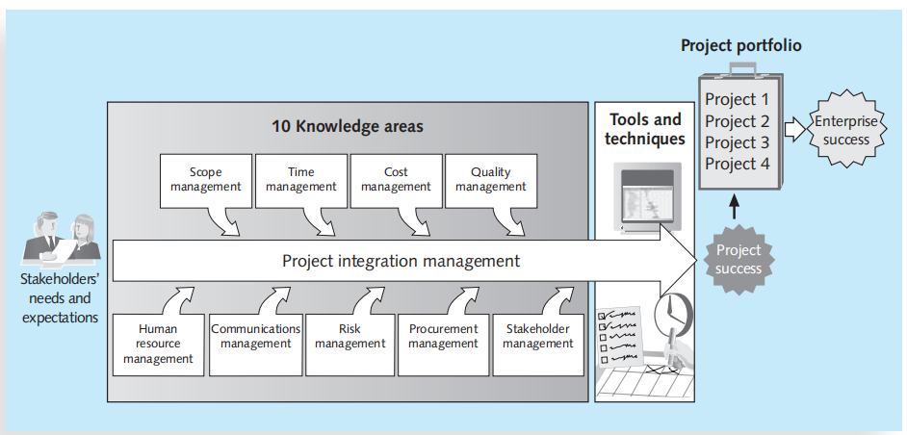
Project Management Knowledge Areas
Project management knowledge areas describe the key competencies that project managers must develop.
Figure 1-2: knowledge areas of project management.

Slide 17
Project Management Knowledge Areas
Project scope management involves defining and managing all the work required to complete the project successfully.
Project time management includes estimating how long it will take to complete the work, developing an acceptable project schedule, and ensuring timely completion of the project.
Project cost management consists of preparing and managing the budget for the project.
Project quality management ensures that the project will satisfy the stated or implied needs for which it was undertaken.
Project human resource management is concerned with making effective use of the people involved with the project.

Slide 18
Project Management Knowledge Areas
Project communications management involves generating, collecting, disseminating, and storing project information.
Project risk management includes identifying, analyzing, and responding to risks related to the project.
Project procurement management involves acquiring or procuring goods and services for a project from outside the performing organization.
Project stakeholder management includes identifying and analyzing stakeholder needs while managing and controlling their engagement throughout the life of the project.
Project integration management is an overarching function that affects and is affected by all of the other knowledge areas.

Slide 19
Project Management Knowledge Areas
Project managers must have knowledge and skills in all 10 of these areas.
Each of these knowledge areas because all of them are crucial to project success.

Slide 20
Project Management Tools & Techniques
Project management tools and techniques assist project managers and their teams in carrying out work in all 10 knowledge areas.
For example, some popular time-management tools and techniques include Gantt charts, project network diagrams, and critical path analysis.
Table 1-1 lists some commonly used tools and techniques by knowledge area.

Slide 21
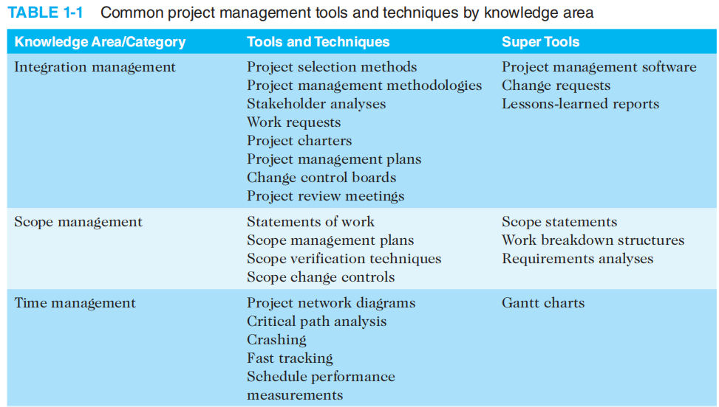
Project Management Tools & Techniques

Slide 22
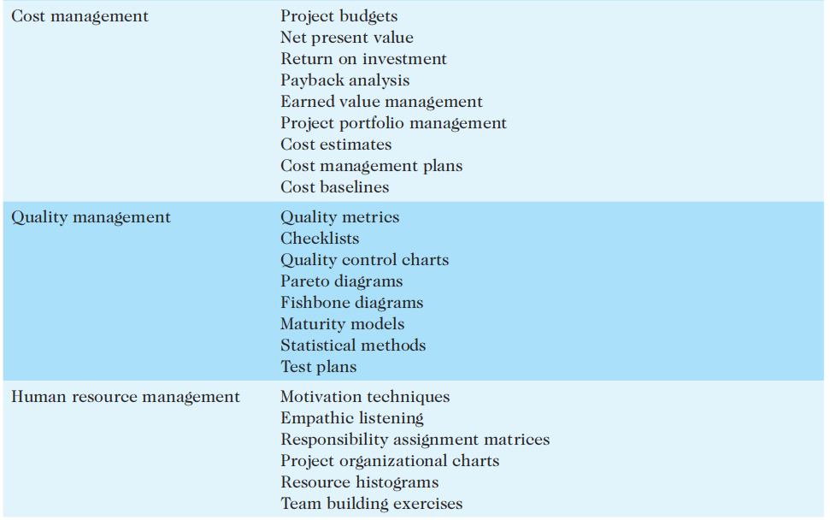
Project Management Tools & Techniques

Slide 23
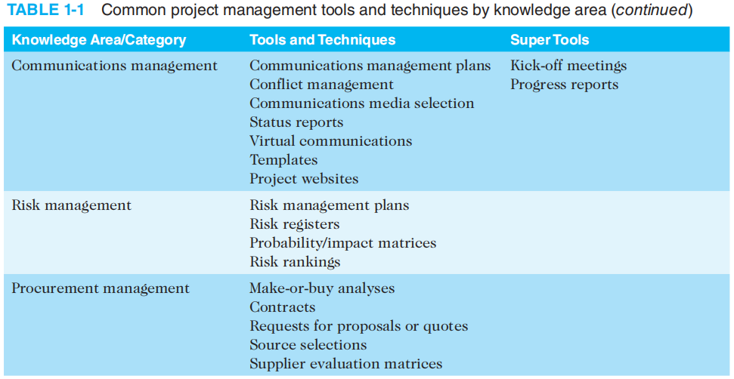
Project Management Tools & Techniques

Slide 24
Project Success
How do you define the success or failure of a project?
The list that follows outlines a few common criteria for measuring the success of a project, illustrating each with an example of upgrading 500 desktop computers within three months for $300,000:

Slide 25
Project Success
The project met scope, time, and cost goals.
If all 500 computers were upgraded and met other scope requirements, the work was completed in three months or less, and the cost was $300,000 or less, you could consider the project successful.

Slide 26
Project Success
The project satisfied the customer/sponsor.
Even if the project met initial scope, time, and cost goals, the users of the computers or their managers might not be satisfied.
Perhaps the project manager or team members never returned calls or were rude.
Perhaps users had their daily work disrupted during the upgrades or had to work extra hours due to the upgrades.
If the customers were not happy with important aspects of the project, it would be deemed a failure.
Conversely, a project might not meet initial scope, time, and cost goals, but the customer could still be very satisfied.

Slide 27
Project Success
Perhaps the project team took longer and spent more money than planned, but they were very polite and helped the users and managers solve several work-related problems.
Many organizations implement a customer satisfaction rating system to measure project success instead of tracking only scope, time, and cost performance.

Slide 28
Project Success
The results of the project met its main objective, such as making or saving a certain amount of money, providing a good return on investment, or simply making the sponsors happy.
Even if the project cost more than estimated, it took longer to complete, and the project team was hard to work with, the project would be successful if users were happy with the upgraded computers, based on this criterion.
As another example, suppose that the sponsor approved the upgrade project to provide a good return on investment by speeding up work and therefore generating more profits. If those goals were met, the sponsor would deem the project a success, regardless of other factors involved.

Slide 29
What helps project to succeed?
Why do some IT projects succeed and others fail?
The factors that contribute most to the success of IT projects are listed in order of importance.
Executive support is the most important factor.
User involvement.
Good scope management, such as having clear business objectives and optimizing scope.
Project management expertise continues to be a key success factor.
experienced project managers, who can often help influence all of these factors to improve the probability of project success,

Slide 30
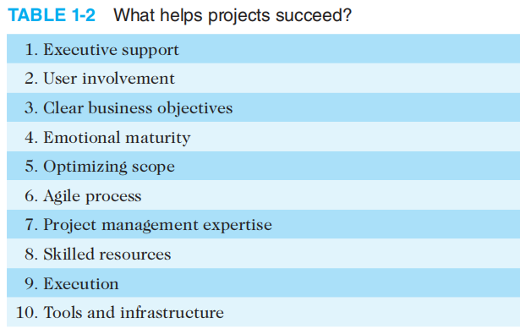
What helps project to succeed?

